Slide 1


 | Nitte Meenakshi Institute of Technology (AN AUTONOMOUS INSTITUTION AFFILIATED TO VISVESVARAYA TECHNOLOGICAL UNIVERSITY, BELGAUM) PB No. 6429, Yelahanka, Bangalore 560-064, Karnataka Telephone: 080- 22167800, 22167860, Fax: 080 - 22167805
Department of Computer Science and Engineering
Decoding Baby Cry
Presentation By:
Abhishek Kushwaha (1NT18CS212)
Khush Dassani (1NT18CS069)
Gaurav Raj Shah (1NT18CS195)
Guided By:
Name of the Guide: Dr. Vani V.
Designation: Professor

Slide 2
TABLE OF CONTENTS
 | Nitte Meenakshi Institute of Technology (AN AUTONOMOUS INSTITUTION AFFILIATED TO VISVESVARAYA TECHNOLOGICAL UNIVERSITY, BELGAUM) PB No. 6429, Yelahanka, Bangalore 560-064, Karnataka Telephone: 080- 22167800, 22167860, Fax: 080 - 22167805
Department of Computer Science and Engineering
Introduction
Background
Research motivation and Problem statement
Research Motivation and Statement of the problem
Objectives of the work
Literature Survey
System Requirements
Design
References

Slide 3
Introduction
Every year, over 130 million infants are born throughout the world.
Taking appropriate care of babies, especially for first-time parents, is a huge task. The fundamental reason is because the significance of newborn screams is difficult to decipher.
Crying is how infants interact with the outside world. Based on their own experiences, experienced parents, caregivers, physicians, and nurses can recognise the screams.
These cries can be put into a machine learning model to figure out why they're crying.

Slide 4
Background
There are numerous works done on this field for synthesising the audio files and decoding it. There have been work done which was able to classify the the reason of the cry with the help of classical machine learning algorithm like SVM (Support Vector Machine) , KNN (k-Nearest Neighbour), Linear Regression etc.
Due to the advancement in technology, we have robust hardware on our disposal which are able to run much taxing applications compared to past. So, we decided to try and decode the baby cries with the help of recent deep learning classification algorithm.

Slide 5
Research Motivation and Problem Statement
Infants communicate with the outer world via crying. Experienced people can recognise the cries based on their own experiences.
Taking proper care of newborns is a tremendous undertaking, especially for first-time parents.
The main reason is because it's tough to discern the importance of infant screaming.
Deep Learning on the other hand is a computer algorithm which is adept at a particular task and have performance similar to that of humans or much more than them with consistency.
We are trying to make use of these model to decode the baby cries and help the parents

Slide 6
Objectives of the Work
Collecting data samples from crying babies by recording sound in the form of a wav file.
Preprocessing the data by extracting features from the sound files for the classical models and creating spectrograms for the newer models.
For the categorization of the cause of infant crying, training the model on the retrieved characteristics.
Comparing various models for the purpose of determining the optimal model for classifying newborn cries.
Deploy and use it to classify the baby cries in real world scenarios.

Slide 7
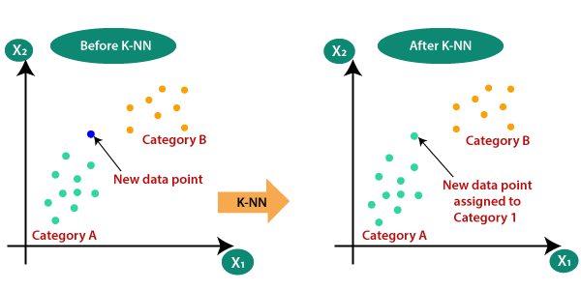
Literature Survey
k-Nearest Neighbours (KNNs)
K-Nearest Neighbour is one of the simplest Machine Learning algorithms based on Supervised Learning technique.
K-NN algorithm assumes the similarity between the new case/data and available cases and put the new case into the category that is most similar to the available categories.

Slide 8

Literature Survey
Support Vector Machine
Support Vector Machine(SVM) is a supervised machine learning algorithm used for both classification and regression. Though we say regression problems as well its best suited for classification.
The objective of SVM algorithm is to find a hyperplane in an N-dimensional space that distinctly classifies the data points.

Slide 9
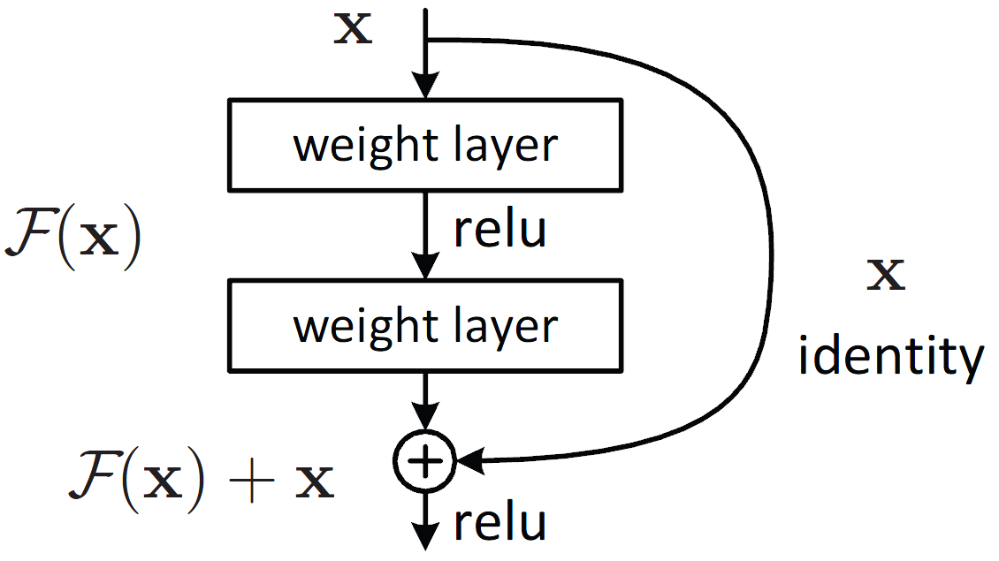
Literature Survey
Deep Convolutional Neural Networks
ResNet
Deeper neural networks are more difficult to train because as the number of layers increases one encounters a problem known as vanishing gradients.
Residual connections are introduced which ensures that the gradients of beginning layers are still preserved and forwarded which resulted in better performance from the models.
Fig. Residual connection

Slide 10
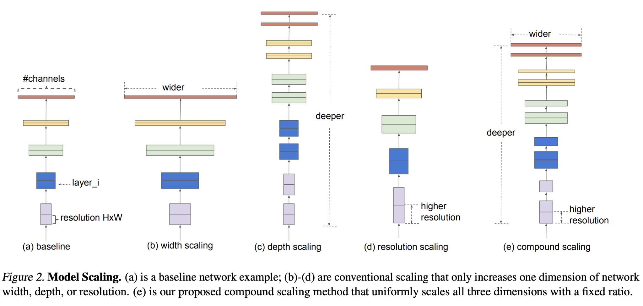
Literature Survey
Deep Convolutional Neural Networks (contd.)
EfficientNet
EfficientNet is a convolutional neural network architecture and scaling method that uniformly scales all dimensions of depth/width/resolution using a compound coefficient.
Unlike conventional practice that arbitrary scales these factors, the EfficientNet scaling method uniformly scales network width, depth, and resolution with a set of fixed scaling coefficients

Slide 11
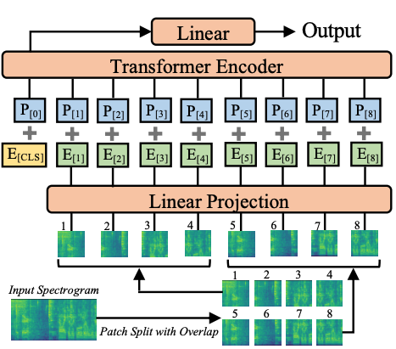
Literature Survey
Audio Spectrogram Transformer
Convolutional neural networks (CNNs) aims to learn a direct mapping from audio spectrograms to corresponding labels.
The Audio Spectrogram Transformer (AST), the first convolution-free, purely attention-based model for audio classification.

Slide 12
System Requirements
Hardware Requirements:
CUDA enabled GPU with VRAM of 4GB or more and having compute capability of 6.0+
Main Memory (RAM) of size 4GB.
Any newer generation of Intel/AMD processor is enough to process the whole script.
A storage of 2GB.
Software Requirements:
Python 3
PyTorch 1.8.0+
CUDA 10.1
Windows/Linux Distro (64-bit)

Slide 13
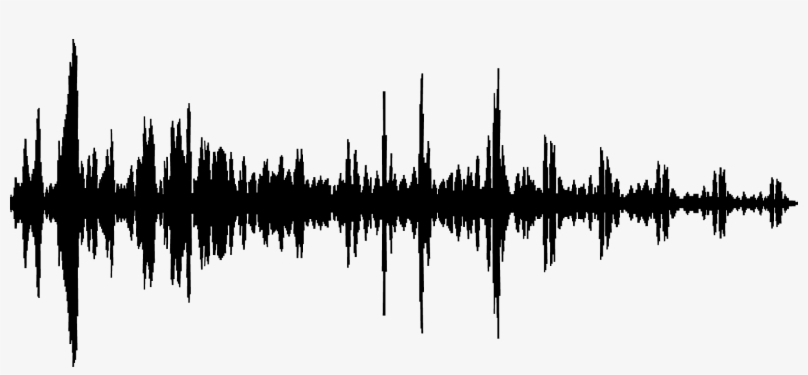
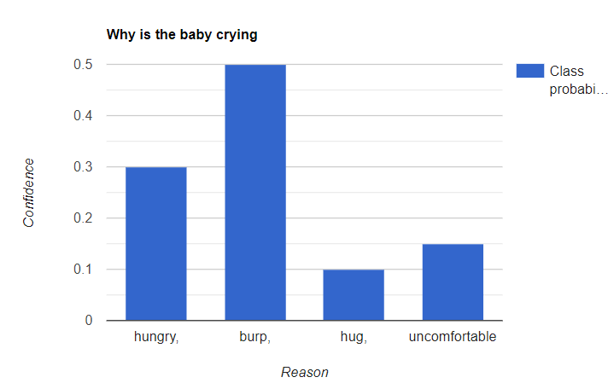
Design
System
Storage
Data preprocessing
Storing the audio files in existing audio formats like .wav, .mp3 etc
Baby cry recorded realtime
Deep Learning Model
Classification

Slide 14
References
Yuan Gong, Yu-An Chung, James Glass et al, “AST: Audio Spectrogram Transformer” 2021
Kaiming He, Xiangyu Zhang, Shaoqing Ren, Jian Sun et al, “Deep Residual Learning for Image Recognition” 2015
Sita Purnama Dewi, Anggunmeka Luhur Prasasti, Budhi Irawan, et al "Analysis of LFCC Feature Extraction in Baby Crying Classification using KNN", IoTAIS, 2014
Mingxing Tan, Quoc V. Le et al, “EfficientNet: Rethinking Model Scaling for Convolutional Neural Networks” 2019
R. Sahak, Y. K. Lee, W. Mansor, A. I. M. Yassin and A. Zabidi et al, "Detection of asphyxiated infant cry using support vector machine integrated with principal component analysis" 2010

